Slide 1

Project Par 3
Cam Pulling, Nick Leisenring, Trevor Moore, Vince Elequin

Slide 2

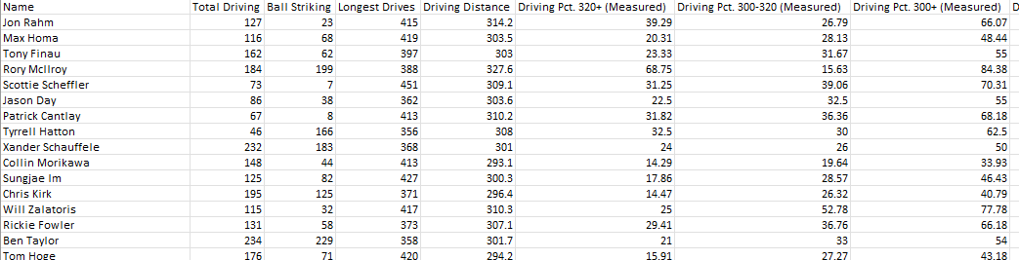
What Sets the Top Golfers Apart?
Examining Statistics of the Worlds Top Golfs

Slide 3

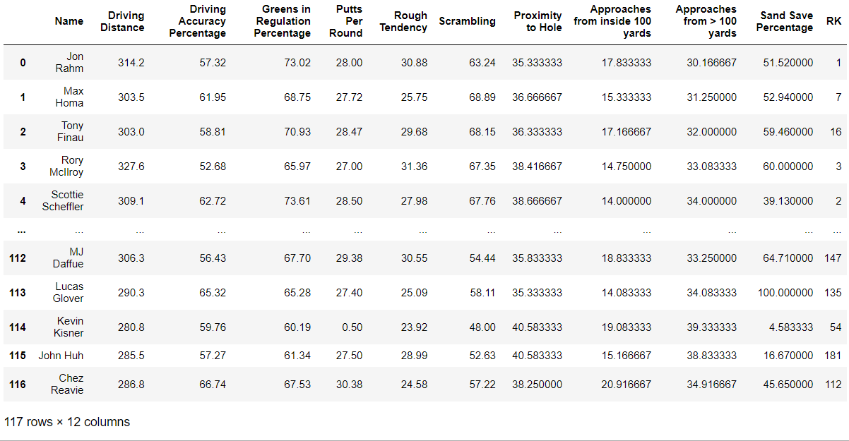
What to look at?
Started with a csv/json of 111 different statistics and 1619 golfers
Cleaned data to 10 important categories and merged with world golf rankings top 200
Dropped any golfer missing data leaving us with a final 117 golfers
Statistics only include PGA Tour Golfers, LIV Tour Players were excluded

Slide 4

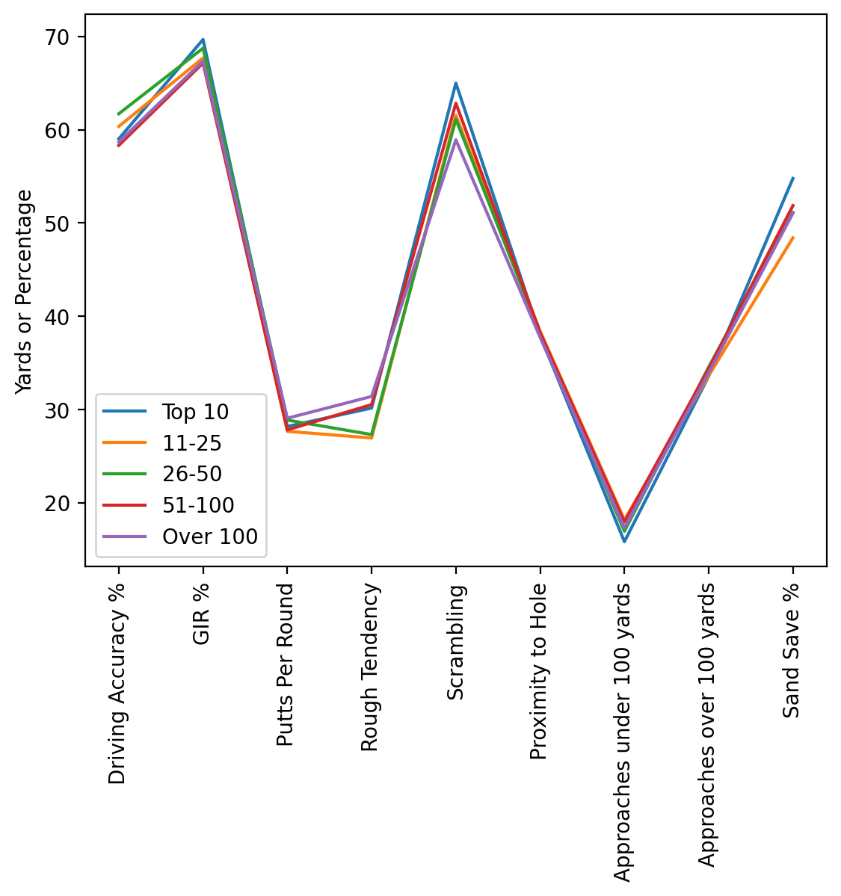
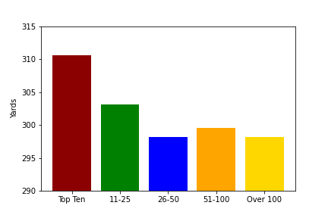
Comparing Groups of Players
Next, we compared the averages of different groups of players based on their World Golf Ranking
The groups are Top 10, 11-25, 26-50, 51-100 and Over 100

Slide 5

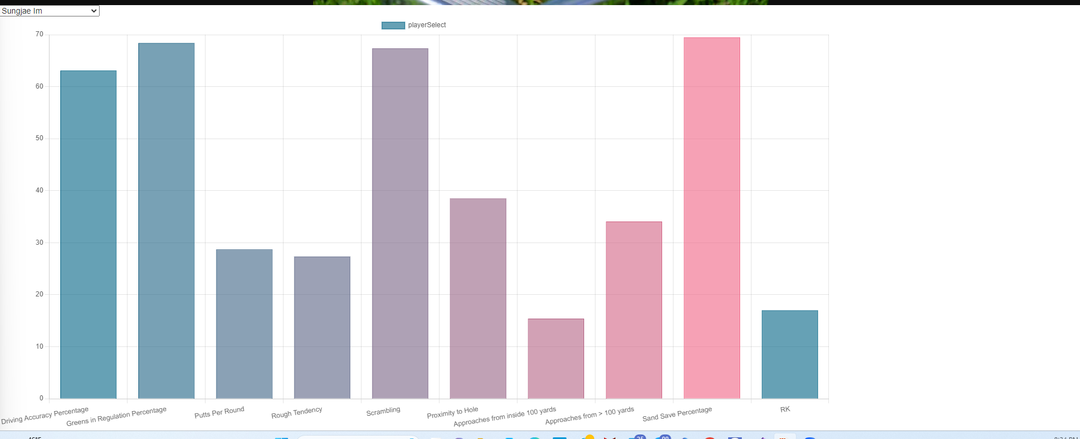
Comparing Players Head-to-Head
Created a drop-down menu to select each player to display their stats for each category
Can use this to compare each player to see where they excel

Slide 6

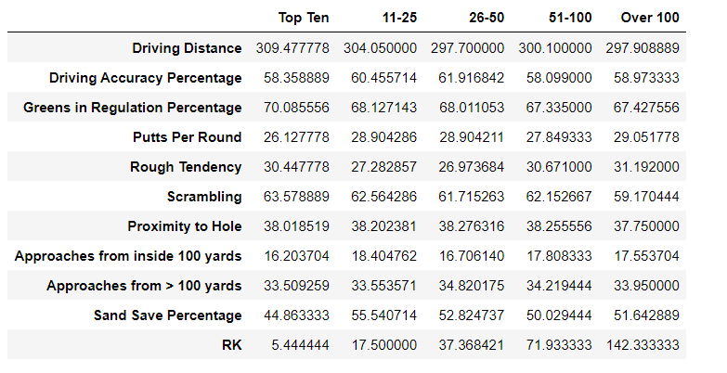
Conclusion
The top golfers did not excel in just any specific category, but almost of them
Of the 10 categories the top 10 was first in six, third in two, fourth in one, and last in one
In areas where they may not excel as much such as Driving Accuracy, they greatly make up for it in other areas such as Putts per round or Approaches from inside 100 yards

